Slide 1

TOPIC-Operating System
COURSE: CCC Concept
CHAPTER: 01 (Operating System)
DAY: 9
NIELIT
Presentation By :Shruti Dubey

Slide 2
Windows-10 Operating System
Window 10 is the most recent version of the Microsoft window operating system. There have been many different version of windows over years, including window 8 (released in 2012), Window 7( released in 2009) and so on.

Slide 3
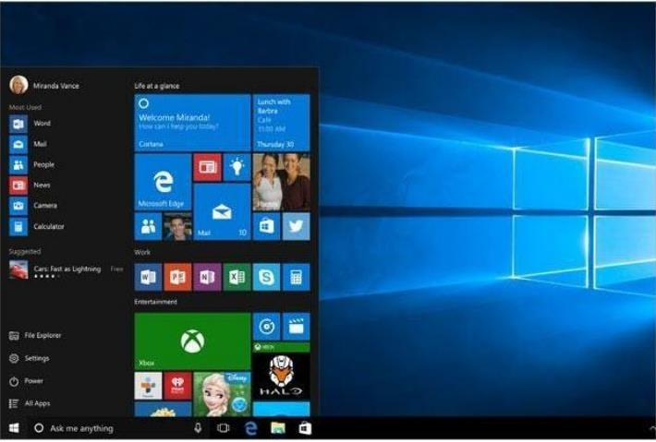
Features of Windows-10
Start menu
Whereas Window 8 uses the start screen to launch applications, window 10 has reintroduced a more traditional start menu. It’s also been expanded to make it easier to find important apps.

Slide 4
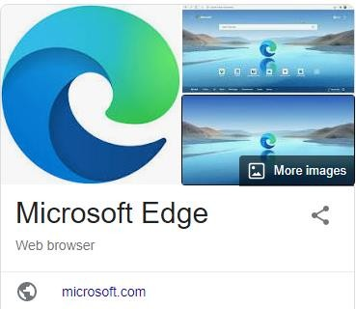
Features of Windows-10
This new browser is designed to give Windows users a better experience on the Web. It's faster, more secure, and includes a lot of new features. Microsoft Edge is meant to replace Internet Explorer as your default web browser, but you'll still be able to use another browser if you prefer.

Slide 5
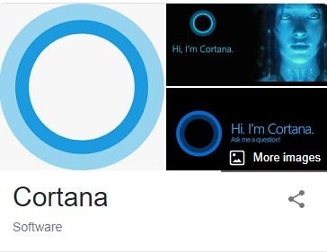
Features of Windows-10
Cortana
Similar to Siri and Google Now, you can talk to this virtual assistant with your computer’s microphone.

Slide 6
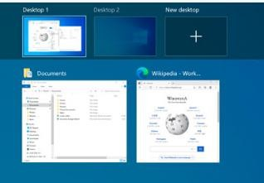
Features of Windows-10
Multiple desktops and Task view
Instead of keeping everything open on the same desktop, you can move some of your windows to a virtual desktop to get them out of the way. And the new Task view feature makes it easy to manage all of your open windows.

Slide 7
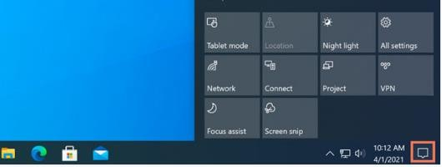
Features of Windows-10
Action Center
The new Action Center is pretty different from previous versions of Windows. For example, it's been expanded to let you access frequently used settings, such as Wi-Fi connectivity and tablets mode . It’s also where you will see important notifications, so if you computer receives an update you’ll get a notification about it here.

Slide 8
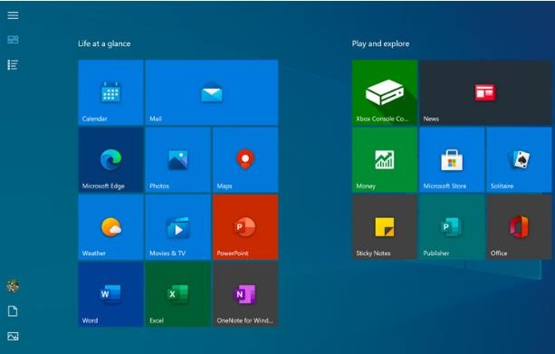
Features of Windows-10
Tablet mode
Unlike Windows 8, Windows 10 makes a clear distinction between desktops and tablets. If you're using a keyboard and mouse with Windows 10, you'll be in desktop mode by default. If your computer also has a touchscreen, you can go into tablet mode at any time. Tablet users can also switch back to desktop mode if they prefer.

Slide 9
The main advantages of Windows 10
Return of the start menu. ...
System updates for a longer period. ...
Excellent virus protection. ...
Addition of DirectX 12. ...
Touch screen for hybrid devices. ...
Full control over Windows 10. ...
Lighter and faster operating system. ...
Possible privacy problems.

Slide 10

Linux Operating System
Just like Windows, iOS, and Mac OS, Linux is an operating system. In fact, one of the most popular platforms on the planet, Android, is powered by the Linux .. (Lovable Intellect Not Using XP)
Linux is a family of open-source Unix-like operating systems based on the Linux kernel, an operating system kernel first released on September 17, 1991, by Linus Torvalds. Linux is typically packaged in a Linux distribution.

Slide 11
Looking to get started in Linux? Develop a good working knowledge of Linux using both the graphical interface and command line across the major Linux distribution families with The Linux Foundation’s, from smartphones to cars, supercomputers and home appliances, home desktops to enterprise servers, the Linux operating system is everywhere.
Linux has been around since the mid-1990s and has since reached a user-base that spans the globe. Linux is actually everywhere: It’s in your phones, your thermostats, in your cars, refrigerators, Roku devices, and televisions. It also runs most of the Internet, all of the world’s top 500 supercomputers, and the world’s stock exchanges.
But besides being the platform of choice to run desktops, servers, and embedded systems across the globe, Linux is one of the most reliable, secure and worry-free operating systems available.
Here is all the information you need to get up to speed on the Linux
platform.

Slide 12
Just like Windows, iOS, and Mac OS, Linux is an operating system. In fact, one of the most popular platforms on the planet, Android, is powered by the Linux operating system. An operating system is software that manages all of the hardware resources associated with your desktop or laptop. To put it simply, the operating system manages the communication between your software and your hardware. Without the operating system (OS), the software wouldn’t function.

Slide 13
Features of Linux Operating System
1. Portable Environment
Linux software operates flawlessly on a variety of hardware platforms. Without the worry of incompatibility, individuals can use Linux operating system on any device. It runs the same way on both high-end and low-end hardware.
2. Free and Open-Source
Its source code is available for anybody to use and alter. Many developers collaborate in organizations to improve and strengthen Linux, and lots of developers constantly work on updating the Linux system.
3. Shell/ Command-line Interface
The Linux system includes essential programs that users can utilize in order to issue commands to the operating system for executing the design flawlessly. You may also direct it to carry out various forms of Linux commands for effectively carrying out the applications.

Slide 14
4. End-to-end encryption
Authentication can help you keep your data protected. Before you may access some critical files, the Linux Operating System requires you to enter a password. Furthermore, the Linux environment allows users to encrypt their data.
5. Graphical User Interface (GUI)
Linux Operating System comes with Graphical User Interface (GUI) abilities in the same way you can with Windows. Similarly, users can install the programs, and the computer graphics will begin to work in the same way that Windows does.
6. Configure Keyboards into Different Languages
Because Linux is available in various languages, it is simple to use it worldwide. As a result, you can change the language on your keyboard as per your preference.

Slide 15
7. Frequent New Updates
Software updates are controlled by the users in Linux. Individuals have the option to pick and choose which updates are required, and there are a plethora of system updates accessible. These upgrades happen considerably more quickly than on other operating systems. Therefore, system upgrades can be deployed without difficulty.
8. Lightweight Infrastructure
Linux is a highly lightweight operating system. Linux has far fewer prerequisites than any other operating system, has a smaller memory footprint, and uses less storage space. Typically, you'll find a Linux Distro with only 128MB of RAM and around the same amount of disc space.
9. Extremely Flexible
Linux is highly flexible, and a variety of desktop applications, embedded systems, and server applications can benefit from the same. It also offers a number of computer-specific limitation settings for admins to allow only essential components to get installed.
10. Best For Developers
Linux supports nearly every popular programming language, including C/C++, Java, Python, Ruby, etc. Furthermore, it provides a wide range of development-related applications.
A majority of developers all around the world prefer the Linux terminal over the Windows command line. On a Linux system, the package manager aids programmers in understanding how things are performed. It also comes with features like bash scripting and supports SSH that aids in the speedy management of servers.

Slide 16
Why use Linux?
Open source
Linux is also distributed under an open source license. Open source follows these key tenants:
The freedom to run the program, for any purpose.
The freedom to study how the program works, and change it to
make it do what you wish.
The freedom to redistribute copies so you can help your neighbor.
The freedom to distribute copies of your modified versions to others.
These points are crucial to understanding the community that works together to create the Linux platform. Without a doubt, Linux is an operating system that is “by the people, for the people”. These tenants are also a main factor in why many people choose Linux. It’s about freedom and freedom of use and freedom of choice.

Slide 17
What is a “distribution?”
Linux has a number of different versions to suit any type of user. From new users to hard-core users, you’ll find a “flavor” of Linux to match your needs. These versions are called distributions (or, in the short form, “distros”). Nearly every distribution of Linux can be downloaded for free, burned onto disk (or USB thumb drive), and installed (on as many machines as you like).
Popular Linux distributions include:
LINUX MINT
MANJARO
DEBIAN
UBUNTU
ANTERGOS
SOLUS
FEDORA
ELEMENTARY OS
OPENSUSE
Each distribution has a different take on the desktop. Some opt for very modern user interfaces (such as GNOME and Elementary OS’s Pantheon), whereas others stick with a more traditional desktop environment (open SUSE uses KDE).

Slide 18
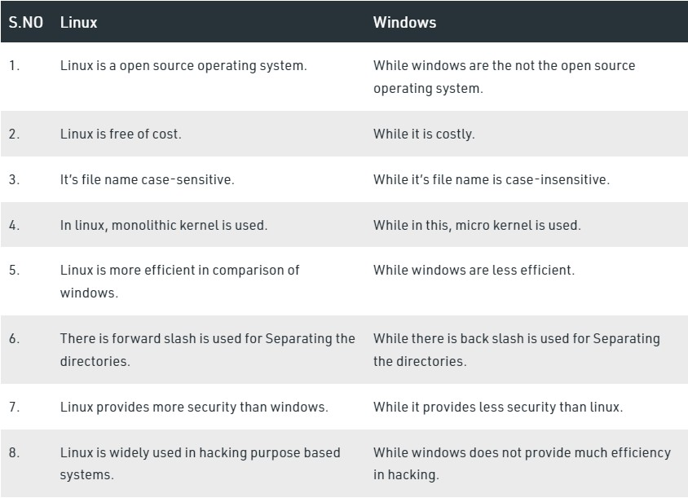
Difference between Linux and Windows OS

Slide 19
UNIX (UNiplexed Information Computing System)
In the late 20th century UNIX was widely used for Internet servers, workstations, and mainframe computers.
Unix is an operating system. It supports multitasking and multi-user functionality. Unix is most widely used in all forms of computing systems such as desktop, laptop, and servers. On Unix, there is a Graphical user interface similar to windows that support easy navigation and support environment.

Slide 20
UNIX
It is a multi-user system where the same resources can be
shared by different users.
It provides multi-tasking, wherein each user can execute many processes at the same time.
It was the first operating system that was written in a high-level language (C Language). This made it easy to port to other machines with minimum adaptations.
It provides a hierarchical file structure which allows easier
access and maintenance of data.
Unix has built-in networking functions so that different users can easily exchange information.
Unix functionality can be extended through user programs built on a standard programming interface.

Slide 21
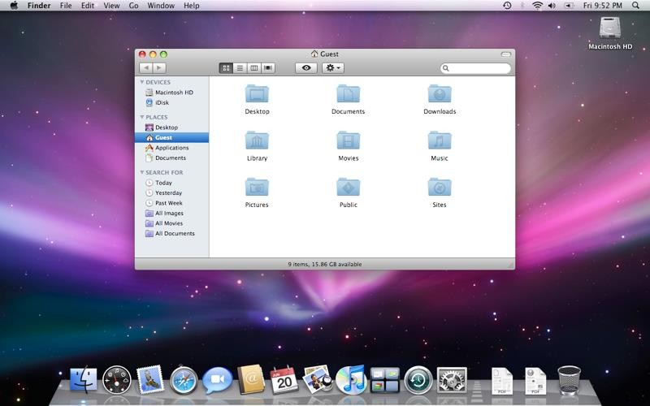
Mac Operating System (Macintosh operating systems)
Mac OS is a Unix-like operating system developed and marketed by Apple Inc. since 2001. It is the primary operating system for Apple's Mac computers.

Slide 22
Mac Operating System (Macintosh operating systems)
1) Mac Operating System was developed by Apple Inc. and released on
24th March 2001.
2) Mac Operating System is mainly used in Apple manufactured Personal Computers.
3) The structure and functionality of the Mac Operating System is based on Unix Operating System.
4) The first version of Mac OS for consumers was ‘Mac OS X 10.0’.
5) ‘Mac OS’ is consistently more secure and less vulnerable than any other operating system.
6) The operating system is available in a total of 38 languages shown at the time of
installation.
7) ‘Mac OS X Server’ is the operating system launched by Apple for desktop servers.
8) ‘Mac OS’ has launched an ‘iOS’ operating system for smartphones in 2007.
9) Since Apple Inc. is also a device manufacturer so they have a seamless
performance between hardware and OS.
10) ‘Mac OS’ currently shares about 14% in desktop operating systems worldwide.

Slide 23
Mac Operating System (Macintosh operating systems)
Mac Operating System is the 2nd most popular operating system for desktop computers.
Mac OS is written using the programming languages C, C++, Objective-C, and Swift.
It is a series of Macintosh Operating System developed by Apple Inc. in 1984.
It was renamed as ‘Mac OS’ in the year 2016.
Strict security updates are released by Apple for ‘MacOS’ regularly.
Virtual assistance for ‘Mac OS’ and other Apple products is launched and named ‘Siri’.
The introduction of ‘Aqua’, a graphic user interface, is the biggest change between classical and current Mac OS.
The ‘Mac OS’ is operated from the Headquarter of Apple Inc. located in California in
the US.
The Mac OS ‘iOS’ is currently having about 13% share in the international market.
The latest version of ‘Mac OS’ is ‘Mac OS 10.15 Catalina’ released on 7th November
2019.

Slide 24
Thank You
NIELIT

